Slide 1
Busi’s Conner Coffee shop
Presented by Nolan Mamathuba _ Coffee shop Analysis October 2025

Slide 2
Busi’s Conner Coffee shop Analysis
Introduction & Background
Analysis
Opportunities Identified
Promotions & Combo
Way-forward & Conclusion

Slide 3
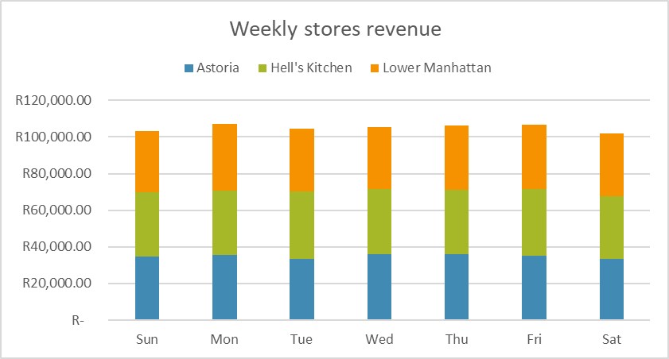
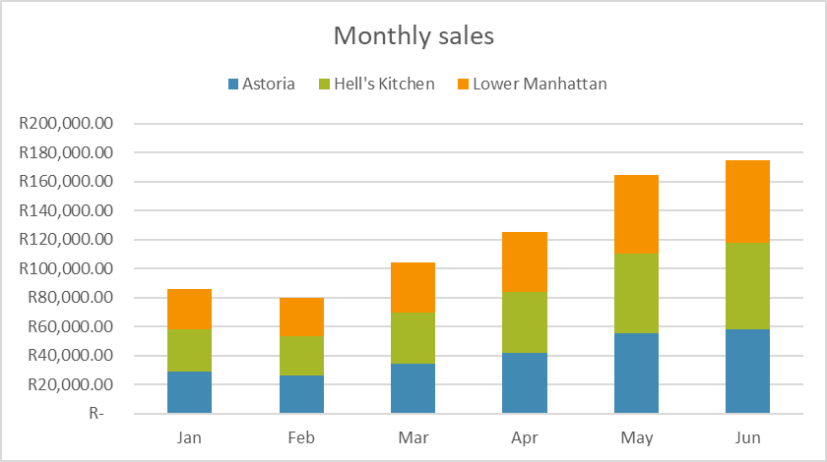
Busi’s Conner Coffee shop Analysis
Our primary findings indicate that mornings and weekends are the busiest. There’s great opportunity to run promotions such as breakfast combos to strategically aim for higher sales volumes.

Slide 4
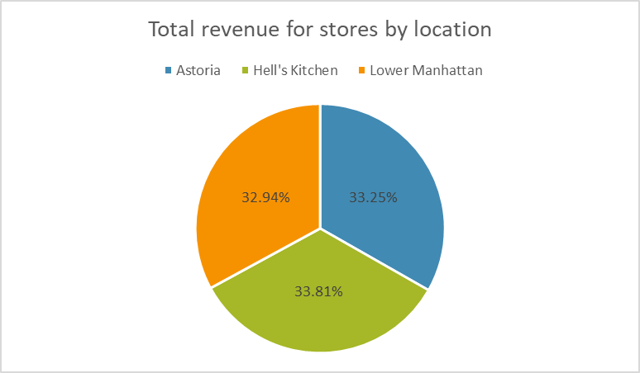
Cappuccino, Americano, and Latte make up the bulk of sales Muffins and croissants sell well when paired with coffee Cold beverages underperform outside summer months Few menu items contribute less than 5% of total sales . If we focus on promoting top performers with combo deals while reviewing low selling items that might add little value to the menu.

Slide 5
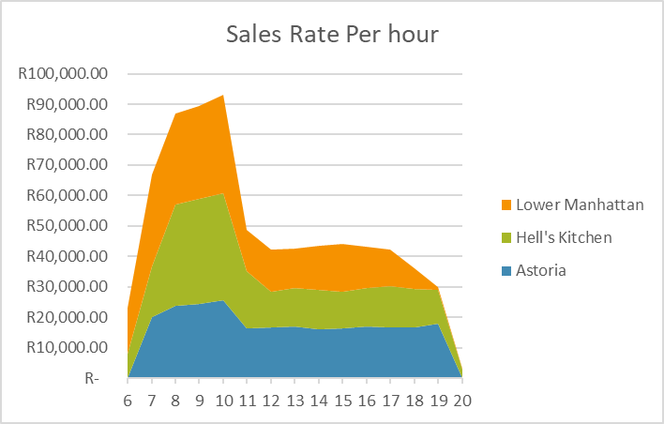
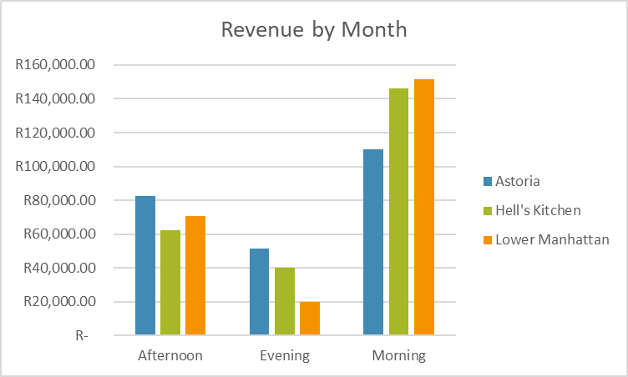
Repeat customers are our core strength around 20% of customers account for over 60% of total sales average spend per customer is rising gradually digital payments and card usage are increasing showing loyalty and convenience preference opportunity to build personalized offers for frequent buyers. A loyalty rewards program or prepaid coffee card could strengthen retention and boost customer lifetime value.

Slide 6
Busi’s Conner Coffee shop Analysis
Pricing & profitability headline
Small pricing adjustments can often drive significant gains premium coffees have steady demand, low price sensitivity combos and discounts sometimes increased volume but reduced profit margin. Food margins are tighter compared to beverages Average transaction value can increase through smart upselling A 5% increase in premium coffee prices and a “coffee + muffin” combo could raise monthly revenue by an estimated 6–8%.

Slide 7
Busi’s Conner Coffee shop Analysis
Store Operations & Efficiency Headline
Operational timing can assist in creating higher sales morning hours (7–10 AM) handle nearly 60% of all transactions afternoon dips indicate potential to run light promotions Staff deployment not fully aligned with sales peaks queue times increase slightly during busy periods insight adjusting staff schedules and prepping for morning surges can improve service speed and enhance customer experience.

Slide 8
Busi’s Conner Coffee shop Analysis
The way forward headline setting the direction for sustainable growth Short-Term (Next 3 Months):
Introduce breakfast combo promotions during peak hours align staff and stock levels to sales trends launch a simple loyalty system to track repeat customers medium-Term (6–12 Months):
Add seasonal drinks to attract repeat visits use sales already existing sales data to forecast and manage inventory better Pilot a subscription coffee service for regulars Long-Term (Beyond 12 Months) expand to close locations with similar demand patterns build a data-driven dashboard to monitor daily performance Strengthen brand positioning around consistency and convenience
The coffee shop already has a loyal base and strong products the next phase is about refining operations, pricing smartly, and deepening customer loyalty.

